Slide 1
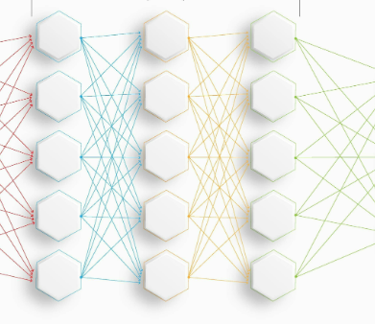
Child Emotion Detection Using Convolutional Neural Networks
Jewel Anns

Slide 2
Contents
Introduction …………………………………………………………………………………………………………. 3
Aims ………………………………………………………………………………………………………………………4
Background study ………………………………………………………………………………………………….5
Methodology………………………………………………………………………………………………………….7
Dataset ………………………………………………………………………………………………………………….8
Augmentation Techniques………………………………………………………………………………………9
Dataset post-augmentation……………………………………………………………………………………11
Proposed CNN Model……………………………………………………………………………………………..12
Evaluation Methods……………………………………………………………………………………………….13
Initial Performance of the model…………………………………………………………………………….14
Regularization Techniques……………………………………………………………………………………..15
Experiments to improve model performance………………………………………………………….16
Accuracy Curves And Confusion Matrices……………………………………………………………….17
Analysis of Experimental Results……………………………………………………………………………21
Conclusion ..………………………………………………………………………………………………………….22
Future Work………………………………………………………………………………………………………….23

Slide 3
Introduction
Recognizing Children's Emotions, an Important task for various purposes, including education and emotional well-being
The Proliferation of Internet Access
Unrestricted Access to Content
Emotional Health Consequences
Care takers ,online educators and therapists can provide required support on time

Slide 4
Aims
Accurately detect child emotions (Anger, Sadness, Happiness)
Perform emotion recognition using a lightweight Convolutional Neural Network (CNN) model, built for minimal CPU consumption
Optimize the model with better accuracy and generalization

Slide 5
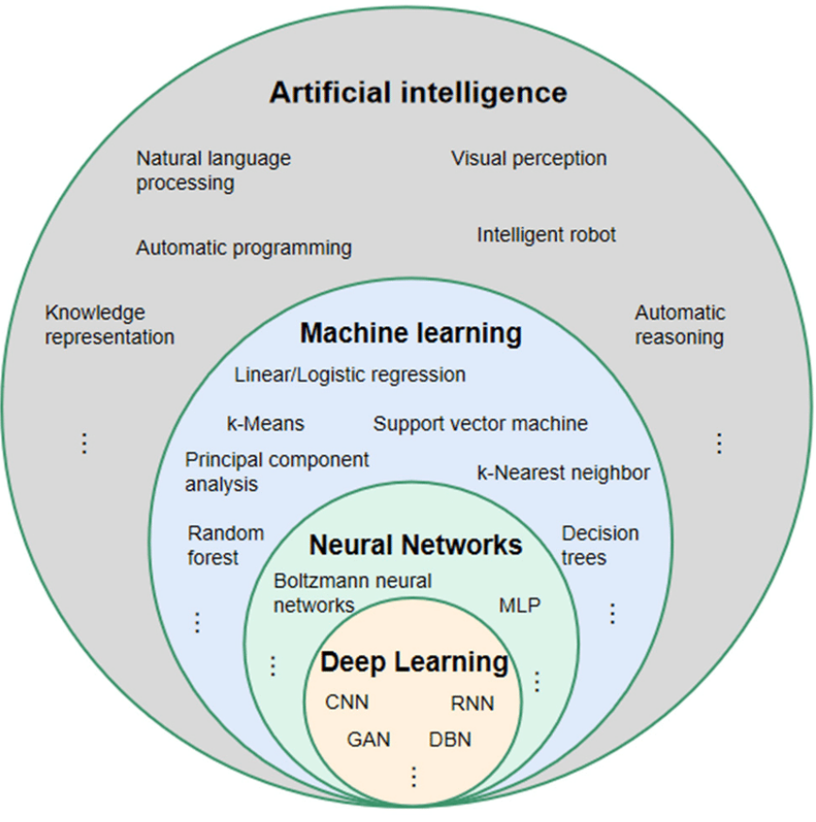
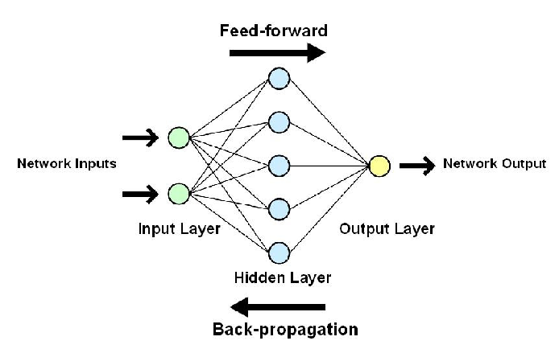
Background Study (AI &CNN)

Slide 6
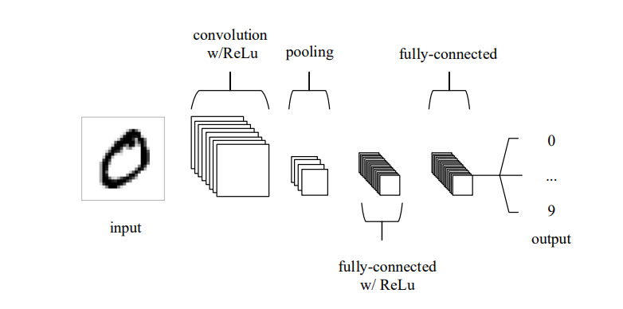
Background Study (AI &CNN) continued..
Layers of simple CNN
Input Layer
Convolutional block
Filters
ReLU Activation
Pooling Layer
Max Pooling
Average pooling
Fully-connected layer
Output Layer

Slide 7
Literature review
Custom CNN approach
Mainly , custom the CNN using various number of hidden layers /filters/activations
Transfer Learning approach
A pre-trained model is used as the starting point for a new task instead of training a model from scratch
Application of facial action units and CNN
Uses facial movement coding using Action Units (AUs) as the classifier output rather than directly classifying emotions from an image
Two-part CNN approach
First component emphasizing the removal of the image's backdrop
The second part concentrating on the extraction of face feature vectors

Slide 8
Methodology
Dataset creation
Augmentation
Build CNN Architecture - Custom CNN approach
Split Dataset to Train , Test and Validation datasets
Train the CNN Model with train dataset
Test the Model with validation dataset
Evaluate the results using evaluation matrices
Use regularization techniques
Perform multiple experiments to improve the results

Slide 9
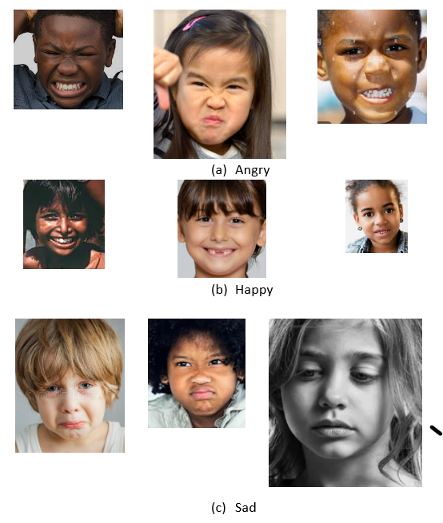
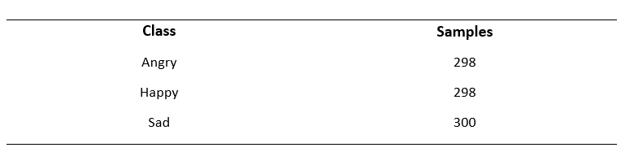
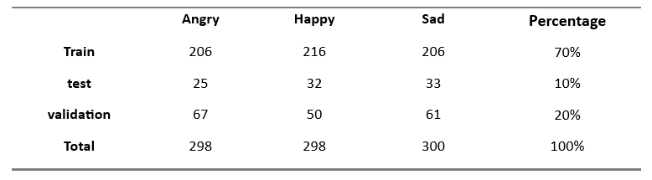
Dataset
Original Dataset

Slide 10
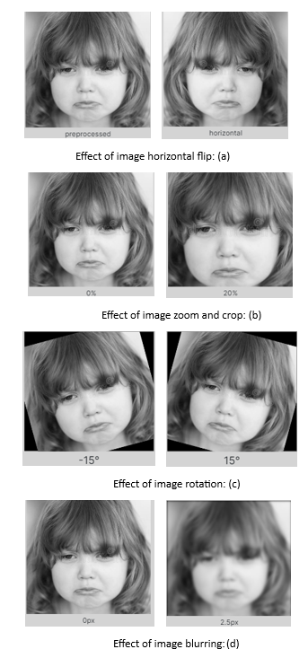
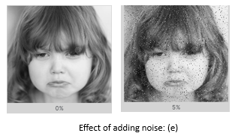
Augmentation Techniques
Scaling operations
Horizontal flip
Resize and crop
Rotation
Blurring
Noise

Slide 11
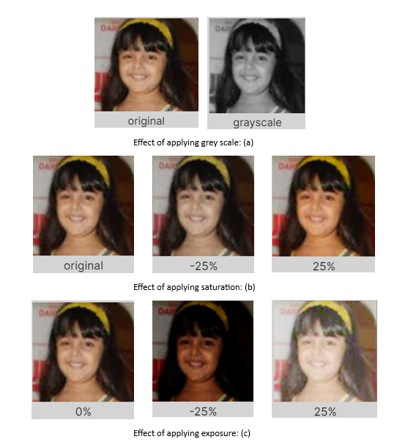
Augmentation Techniques Continued..
Contrast Operations
Grey scale
Saturation
Exposure

Slide 12
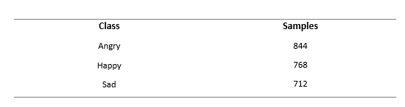
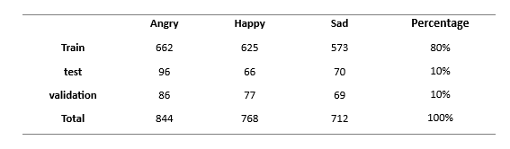
Dataset Post-Augmentation

Slide 13
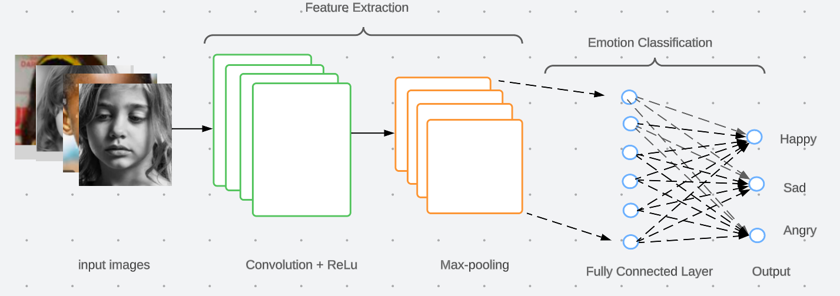
Proposed CNN Model
Input layer
Input tensor with 3 channels (often corresponds to RGB)
Feature Extraction Layer
2D Convolution Layer (11 filters)
Add Non-Linearity by ReLU activation
Pooling Layer:2D Max pooling picks the highest values to down sample
Emotion Classification Layer
Fully Connected layer with 40 out features
Output Layer
Classification to three emotions: Happy, Sad and Angry
Softmax activation function

Slide 14
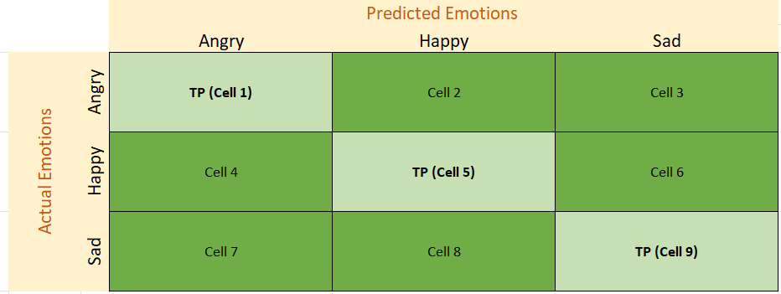
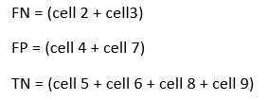

Evaluation Methods
Evaluation Techniques
Degree of Overfitting
Train Accuracy
Validation Accuracy
Confusion Matrix for Multi-class
Precision and Recall
F1 Score of emotion ‘Angry’

Slide 15
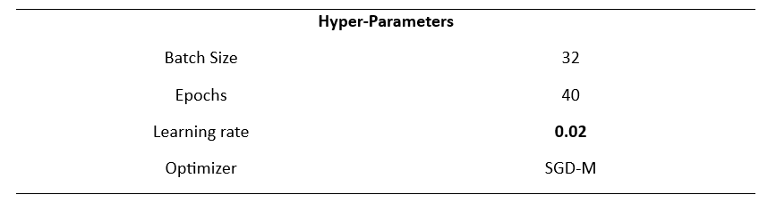
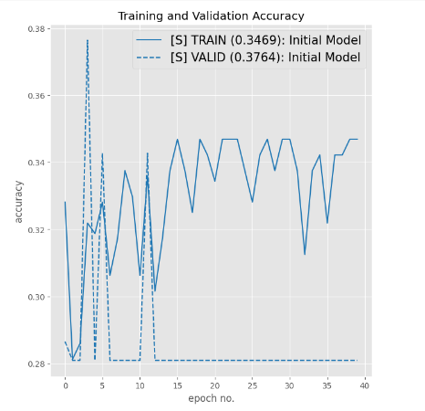
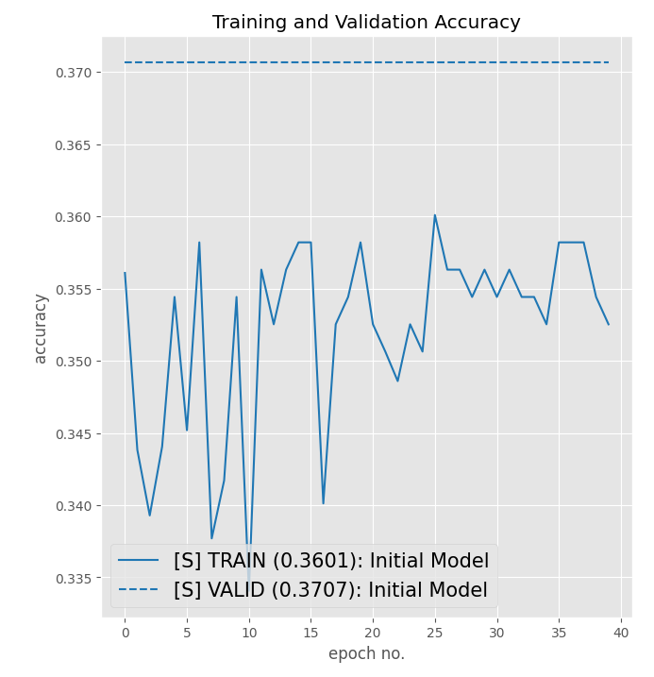
Initial Performance of model
Original Dataset Augmented Dataset

Slide 16
Regularization Techniques
Hyper parameter tuning
Learning rate (0.02, 0.001)
Epochs (40, 60)
Batch Normalization
Dropouts
1% , 2%, 3% , 4%
Integrated approach (Batch normalization + dropout)
Modification of model
Adding filters (double the baseline)

Slide 17
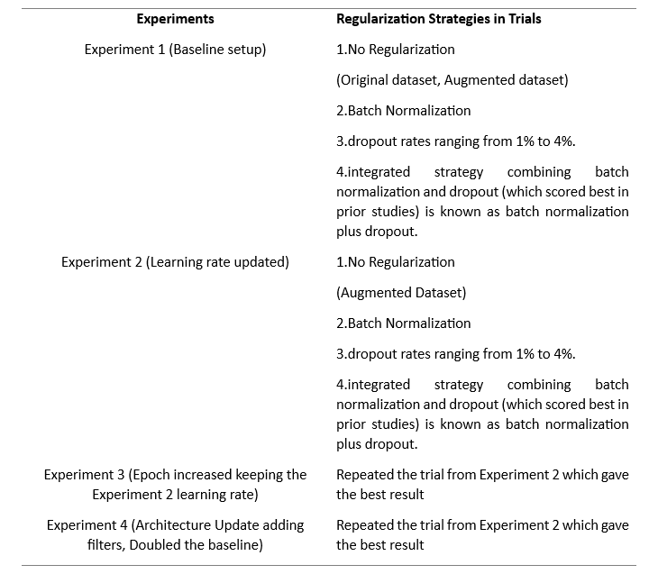
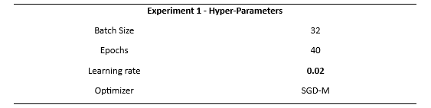
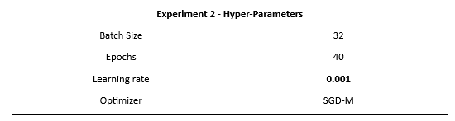
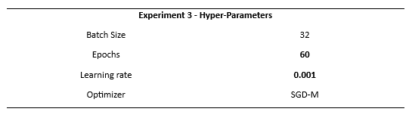
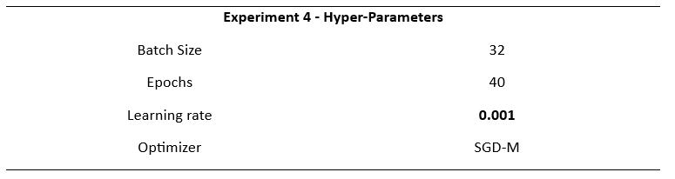
Experiments to improve the model performance

Slide 18
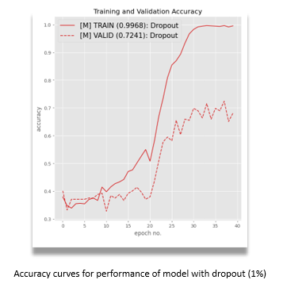
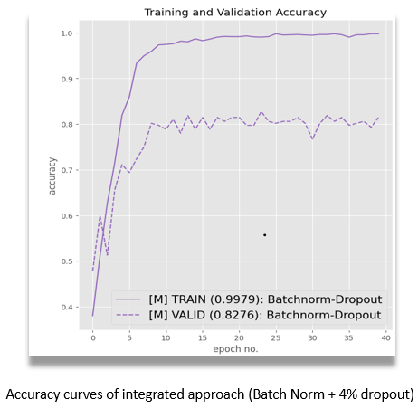


Accuracy Curves: High Performance Trials
Experiment 1 Experiment 2

Slide 19
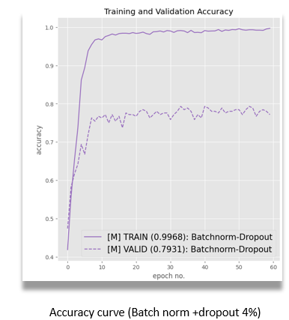
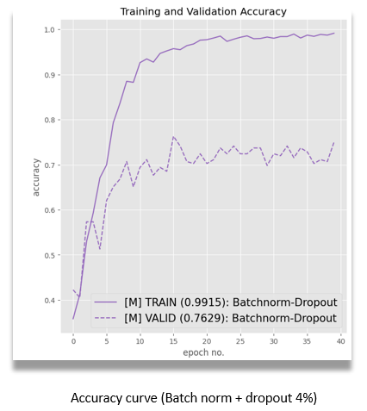

Accuracy Curves Continued..
Experiment 3 Experiment 4

Slide 20
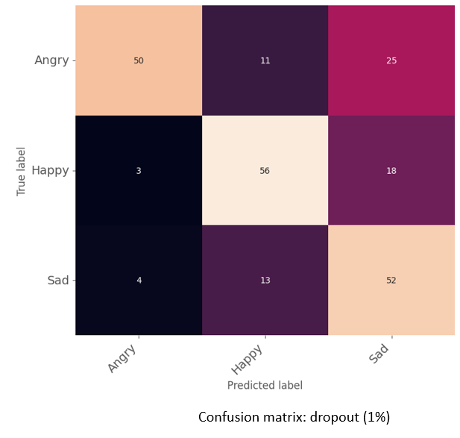
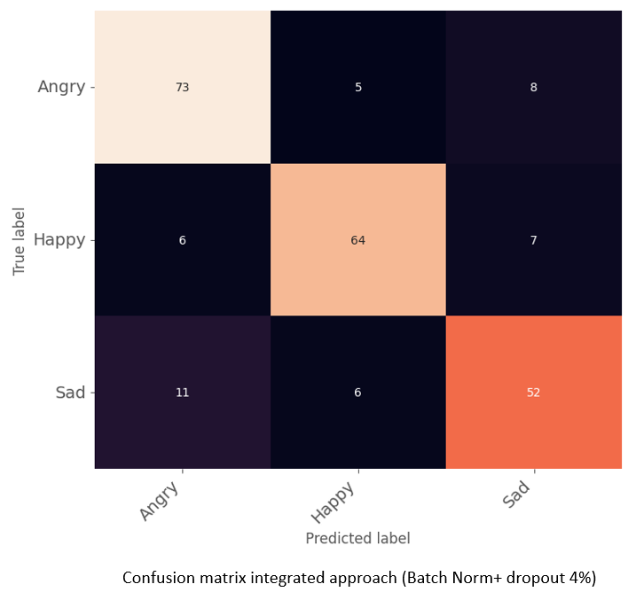
Confusion Matrix: High performance Trials
Experiment 1 Experiment 2

Slide 21
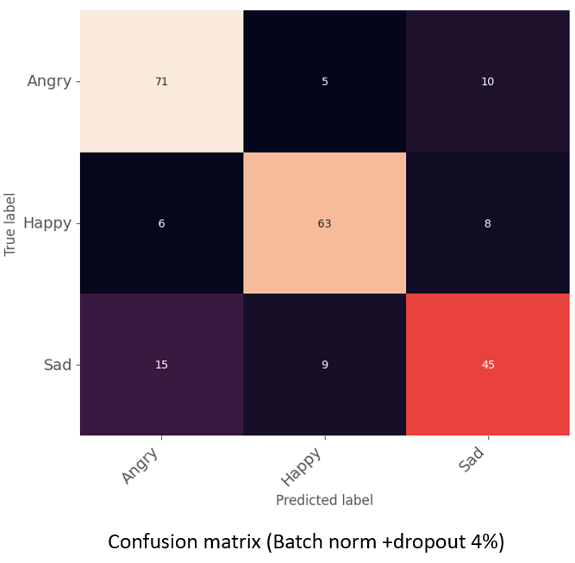
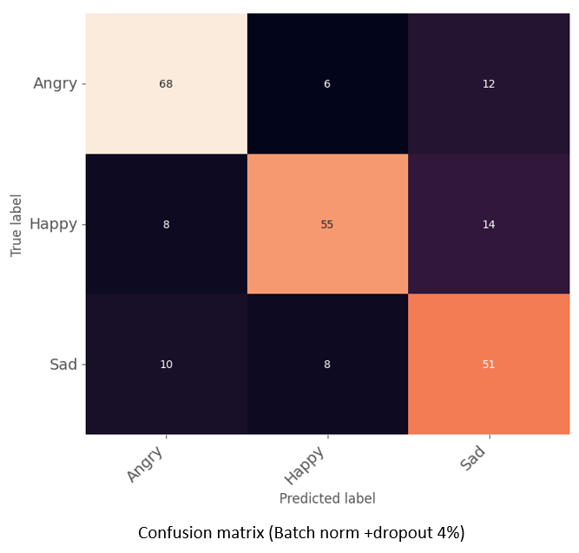
Confusion Matrix Continued….
Experiment 3 Experiment 4

Slide 22
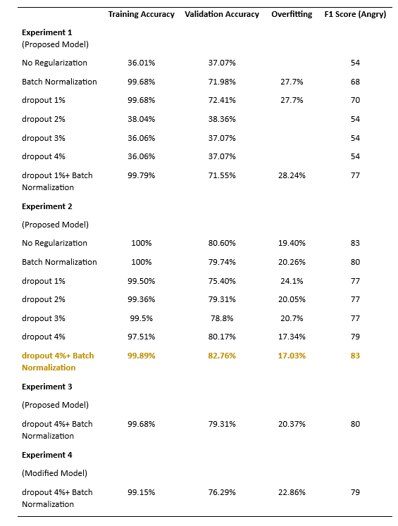
Analysis of Evaluation Results

Slide 23
Conclusion
Proposed lightweight CNN model for child emotion detection using restricted computational resources
Four Experiments with different trials implementing different augmentation techniques to improve the model performance
Experiment 1,2 and 3 - Augmentation techniques
Hyper parameter tuning
Batch normalization and dropouts
Experiment 4
Modifying model by doubling the filters in baseline model
Evaluation Criteria
Accuracy, Overfitting, F1 score (emotion- Anger)
Experiment 2 – integrated approach best performer among all four experiments (overfitting at 17.03%, validation accuracy of 82.76%, and an F1 score of 83 for the ‘Anger’ emotion)
Limitation of study in assessing model on only one emotion and moderate overfitting. Future work to rectify.

Slide 24
Future Work
Best Performed trial (Experiment 2 –Integrated approach) has an over fitting 17.03%, So to reduce this
Future experiments with L1 L2 regularization techniques in combination with batch normalization and dropout
Model assessed on only one emotion – ‘Anger’ due to time constraints
Future work to concentrate on each emotion
Best performed trial has 82.76 % validation accuracy , To improve this
Transfer learning approach to experiment
Pre-train the model on each emotion using different datasets
Fine tune it on child dataset

Slide 25
Thank You…

Slide 26

Any Questions?

